Slide 1
Testing File
This file is used to test uploading and system operation. It contains no live content. The following slides are purely for test purposes.

Slide 2
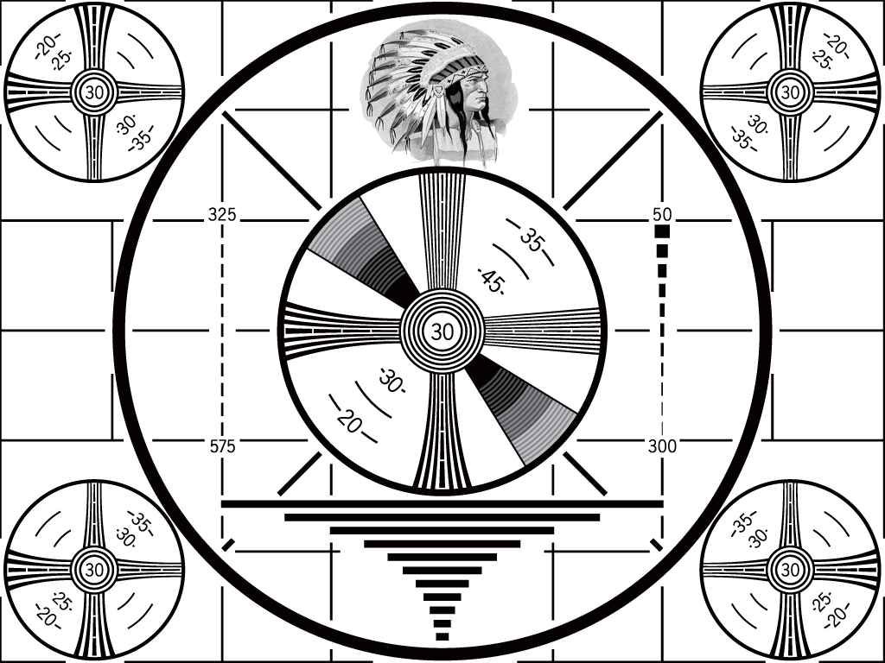
Image Test #1

Slide 3
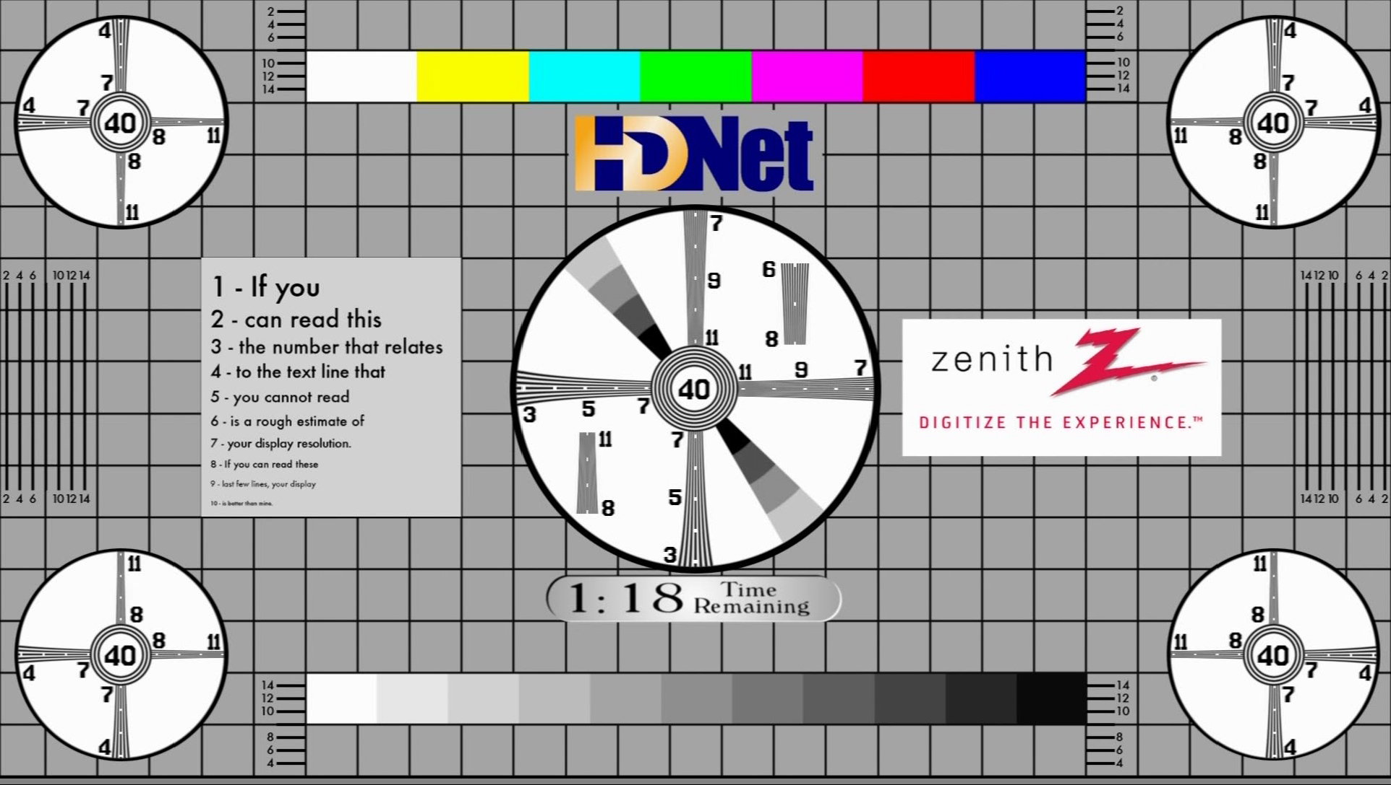
Image test #2

